Slide 1
Identification
Cart identification

Slide 2
Identification
Mass of the cart?
Damping and stiffness of the springs?
Detach the cart from the motor, and perform experiments!
Is the response to an initial condition x(0), where C depends
On x(0)
Find the period T => pulsation
Find the damping ratio
Find stiffness and mass

Slide 3
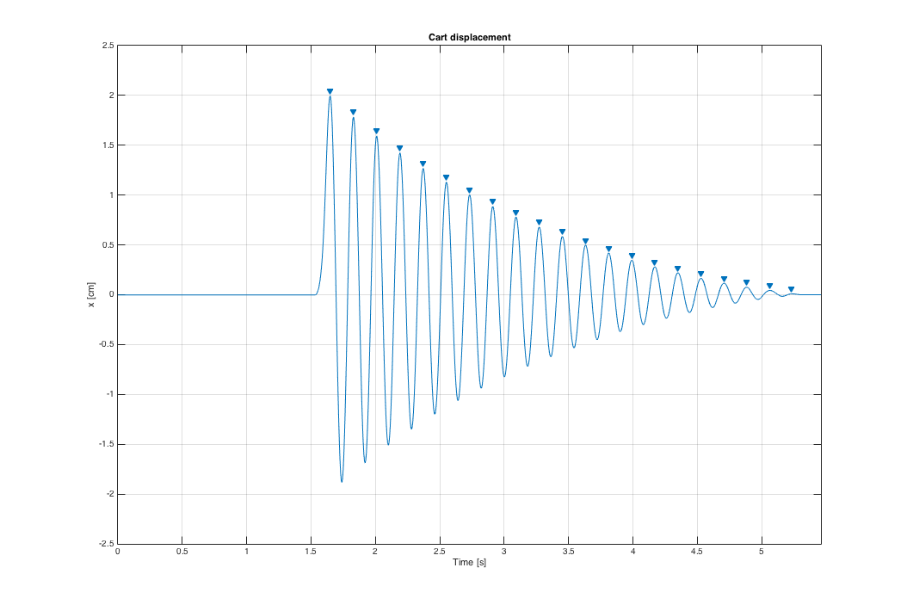
Identification
T
X(0)
X(T)
w= 2pi/T

Slide 4
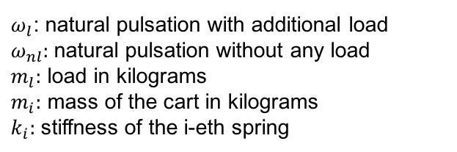

Identification
To find the stiffness of the spring and the mass of the cart we need two equations..
Since we have 2 unknown variables! But what coefficient do we change? The mass!
We know the load!
Remember, $ω_{}^{2}=\frac{K}{M}$
$ω_{l}$: natural pulsation with additional load
$ω_{nl}:$natural pulsation without any load
$m_{l}:$ load in kilograms
$m_{i}:$ mass of the cart in kilograms
$k_{i}:$ stiffness of the i-eth spring

Slide 5
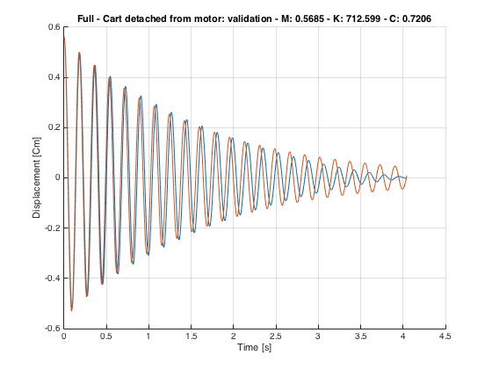
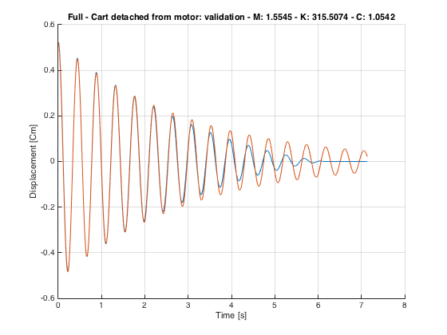
Identification
Validation
Identification: use same x(0)
Validation: random x(0)
Orange: simulated signal
Blue: real signal
Friction effect!

Slide 6
Identification
Overall system
Identification

Slide 7
Identification
So far we estimated the main parameters of the motor, and of the cart.
We still miss:
Electrical torque constant
Inertia of the motor/pinion/rack
Induced stiffness and damping of the motor
Therefore: attach the cart to the rack, use same experiments used to identify the motor, and use the techniques presented before to estimate the mass/inertia, stiffness, damping, etc…

Slide 8

Identification
What about electrical torque constant?
Remember, $x\left(s\right)=G_{2}\left(s\right)G_{1}\left(s\right)v\left(s\right)$
,
Electrical torque
constant
Force transmitted from the motor:
Diameter of the pinion
To identify gamma use:
Where infinity stands for steady state

Slide 9
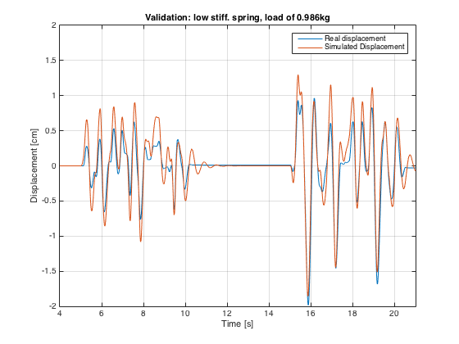
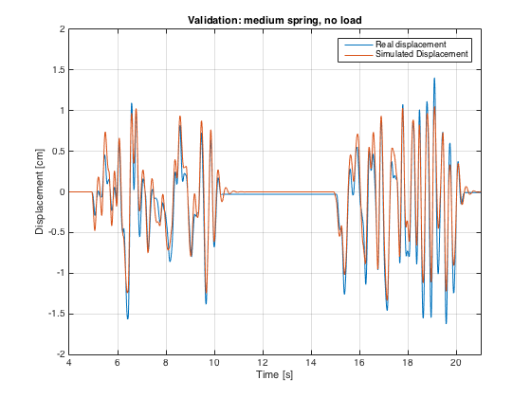
Identification
Validation – 1 DOF
Used white noise for validation! Friction effects are still visible
85.42% of fit

Slide 10
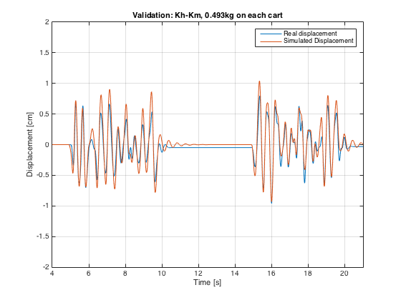
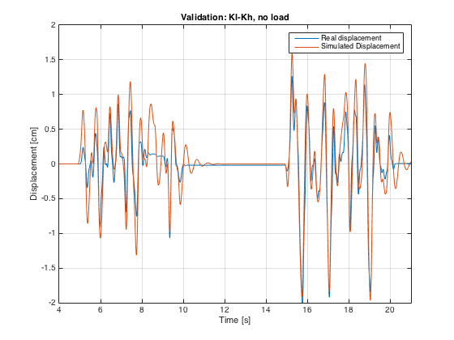
Identification
Validation – 2 DOF
87.29% of fit for the first cart, 85.79% for the second one. Plots shown only for
the second cart

Slide 11
Identification
Gray Box Identification

Slide 12
Identification
Since the identification process was long, we first used a rapid approach to estimate
All the variables in play.
Feed a train of pulses into the system and measure both the current and
displacement of the cart
Measured
Simulated

Slide 13
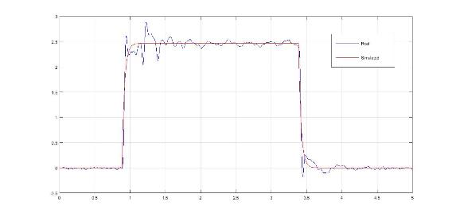
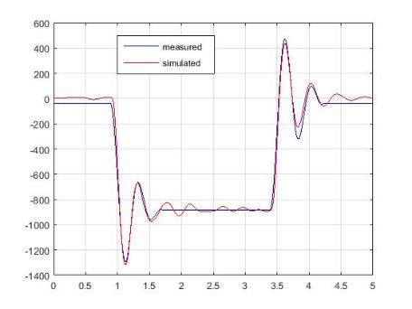
Identification
Identification results
Cart
Motor

Slide 14
Identification
Non Linearities Identification

Slide 15
Identification
Non Linear Gain
During the course of the project we found many non-linearities, especially in the
Motor, responsible of poor performances in some cases.
One of the most important was that the gain was input-dependant.
We performed multiple experiments, using a step signal, at different voltages.
Ideal current, simulated
Real current, measured
Least squares
Approximation of f(v)

Slide 16
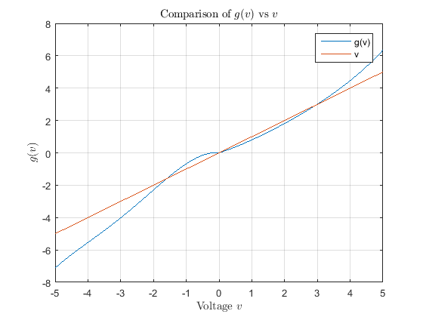
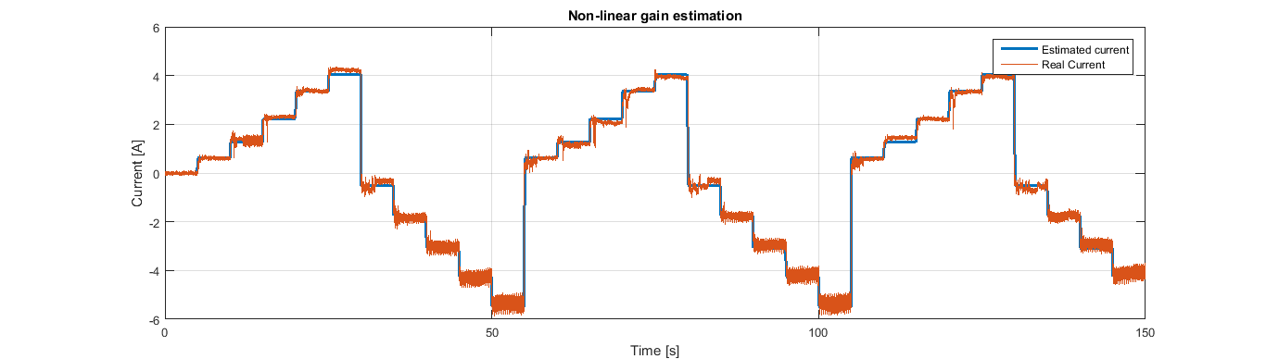
Identification
As seen from the figure,
f(v)=g(v)/v is a nonlinearity with
sector [a,b], a >0, b < infinity.
Results:

Slide 17
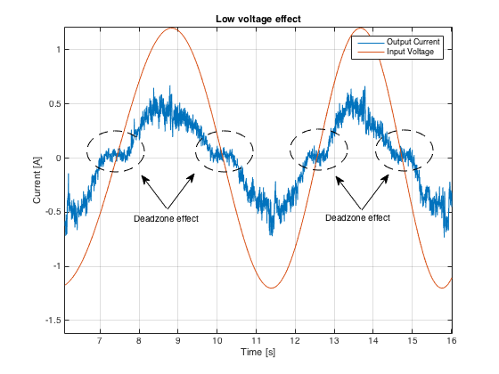
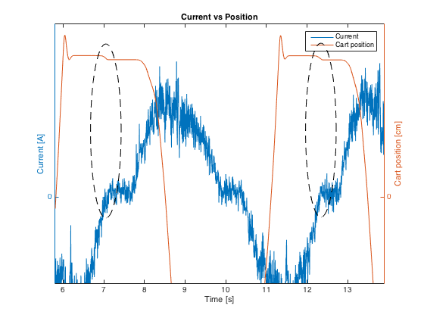
Identification
Motor Electrical Friction
Find c?
Minimize a cost function
Or use the fact that the current is WN

Slide 18
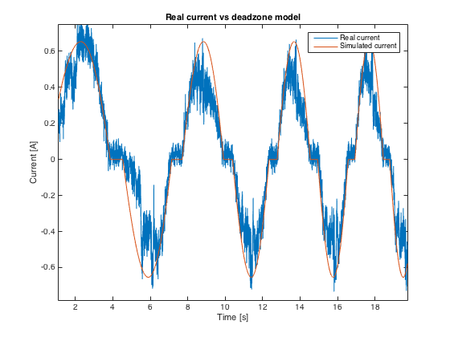
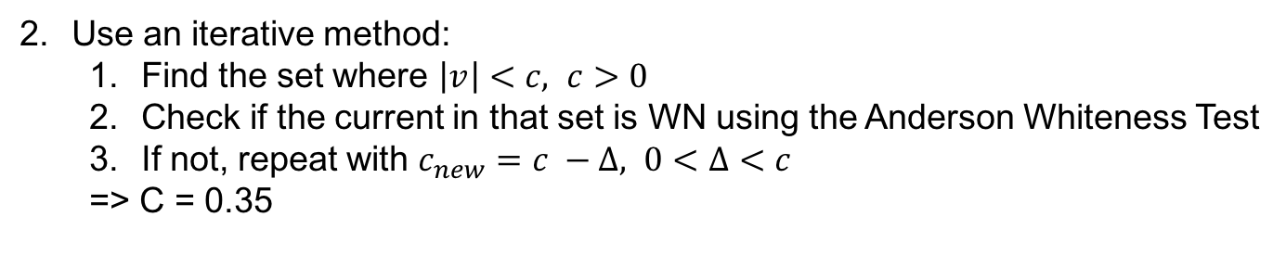
Identification
1. Minimize:
=> c= 0.4621, using genetic algorithm
Use an iterative method:
Find the set where $\left|v\right|<c, c>0$
Check if the current in that set is WN using the Anderson Whiteness Test
If not, repeat with $c_{new}=c −Δ, 0<Δ<c$
=> C = 0.35

Slide 19
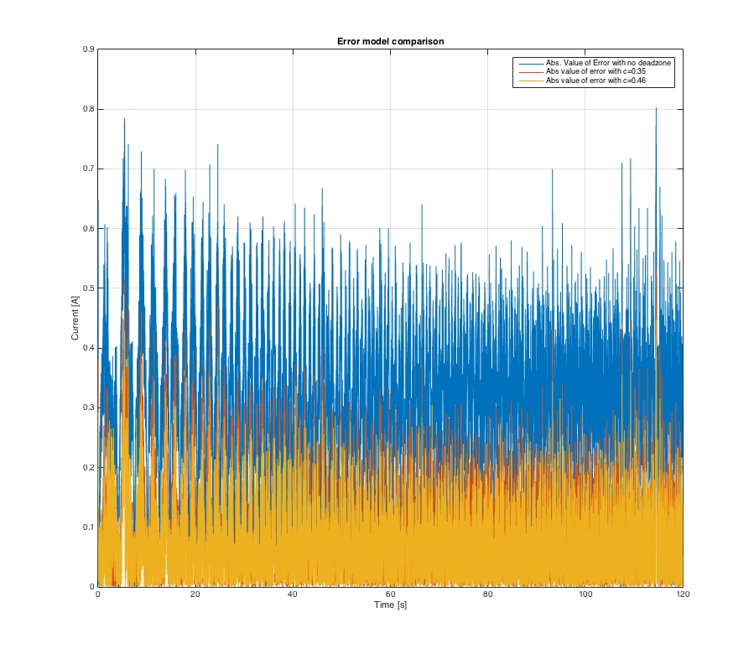

Identification
Plot of $e\left(t\right)=i_{real}−i_{sim}$
C=0.46 slightly outperforms C=0.35

Slide 20
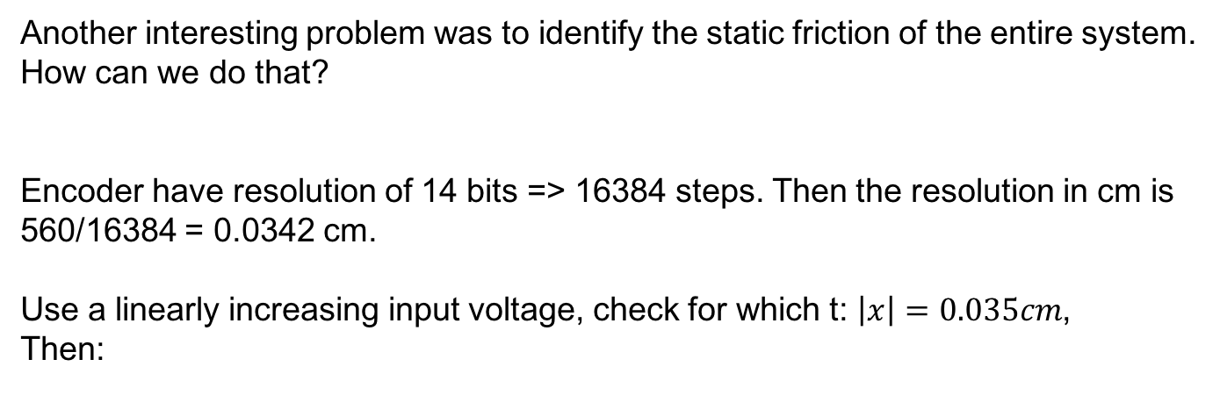
Identification
Static Friction
Another interesting problem was to identify the static friction of the entire system.
How can we do that?
Encoder have resolution of 14 bits => 16384 steps. Then the resolution in cm is
560/16384 = 0.0342 cm.
Use a linearly increasing input voltage, check for which t: $\left|x\right|=0.035cm$,
Then:
Force transmitted
Knowledge of the other
Nonlinearities was needed
In order to estimate the friction
Correctly!
Where N is the load,
i the current at time t.

Slide 21
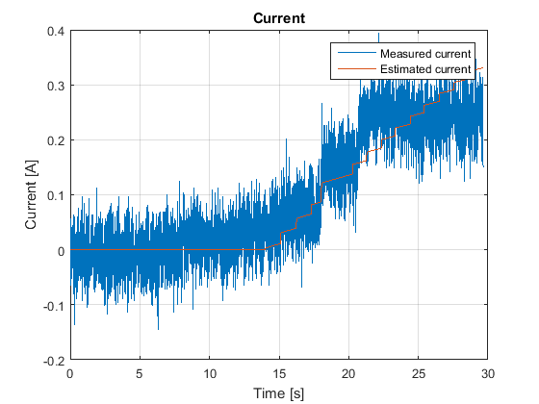
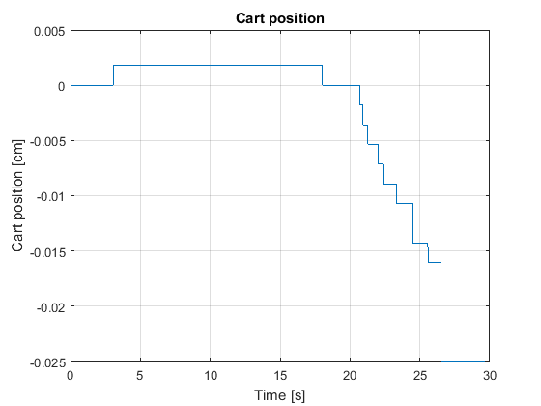
Identification
Static Friction

Slide 22
Identification
Filtering

Slide 23
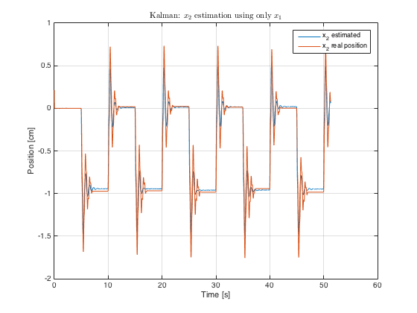
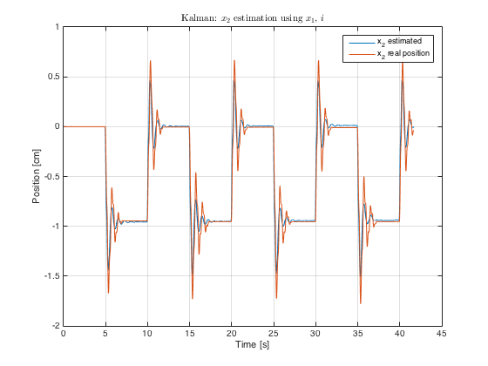
Identification
Noisy current sensor, third encoder not available. How to do state feedback,
Pole placement, etc…?
Use of Luenberger/Kalman observer. Tests done:
Estimate of the carts position (all 3 degree of freedom) using only the current.
Estimate of the carts position (second and third cart) using the current and the data from the first encoder.
Estimate of the carts position (second and third cart) using only the data from the first encoder.
90% fit

